Slide 1


Data Analysis Using
Python
Lecture-4
www.bennett.edu.in
www.bennett.edu.in

Slide 2
FILE HANDLING AND READING DATA FOR PROCESSING
INTRODUCTION
DATA FILES
OPENING AND CLOSING FILES
READING AND WRITING FILES
STANDARD INPUT, OUTPUT AND ERROR STREAMS
Read and write data in CSV files

Slide 3
Introduction
FILE HANDLING is a mechanism by which we can read data of disk files in python program or write back data from python program to disk files.
So far in our python program the standard input in coming from keyboard an output is going to monitor i.e. no where data is stored permanent and entered data is present as long as program is running BUT file handling allows us to store data entered through python program permanently in disk file and later on we can read back the data

Slide 4
DATA FILES
It contains data pertaining to a specific application, for later use. The data files can be stored in two ways –
Text File
Binary File

Slide 5
Text File
Text file stores information in ASCII OR UNICODE character. In text file everything will be stored as a character for example if data is “computer” then it will take 8 bytes and if the data is floating value like 11237.9876 it will take 10 bytes.
In text file each line is terminated by special character called EOL. In text file some translation takes place when this EOL character is read or written. In python EOL is ‘\n’ or ‘\r’ or combination of both

Slide 6
The carriage return is represented by the escape sequence ‘\r ‘.

Slide 7
Binary files
It stores the information in the same format as in the memory i.e. data is stored according to its data type so no translation occurs.
In binary file there is no delimiter for a new line
Binary files are faster and easier for a program to read and write than text files.
Data in binary files cannot be directly read, it can be read only through python program for the same.

Slide 8
Steps in Data File Handling
OPENING FILE
We should first open the file for read or write by specifying the name of file and mode.
PERFORMING READ/WRITE
Once the file is opened now we can either read or write for which file is opened using various functions available
CLOSING FILE
After performing operation we must close the file and release the file for other application to use it,

Slide 9
Opening File
File can be opened for either – read, write, append.
SYNTAX:
file_object = open(filename)
Or
file_object = open(filename,mode)
** default mode is “read”

Slide 10
Opening File
For example, we want to open a file named as story.txt. Then, it can be opened as:
myfile = open(“story.txt”)
here disk file “story.txt” is loaded in memory and its reference is linked to “myfile” object, now python program will access “story.txt” through “myfile” object.
here “story.txt” is present in the same folder where .py file is stored otherwise if disk file to work is in another folder we have to give full path.

Slide 11
Opening File
myfile = open(“article.txt”,”r”)
here “r” is for read (although it is by default, other
options are “w” for write, “a” for append)
myfile = open(“d:\\mydata\\poem.txt”,”r”)
here we are accessing “poem.txt” file stored in
separate location i.e. d:\mydata folder.
at the time of giving path of file we must use double backslash(\\) in place of single backslash because in python single slash is used for escape character and it may cause problem like if the folder name is “nitin” and we provide path as d:\nitin\poem.txt then in \nitin “\n” will become escape character for new line, SO ALWAYS USE DOUBLE BACKSLASH IN PATH

Slide 12
File Access Mode
Text File Mode | Binary File Mode | Description | Notes
‘r’ | ‘rb’ | Read only | File must exists, otherwise Python raises I/O errors
‘w’ | ‘wb’ | Write only | If file not exists, file is created If file exists, python will truncate existing data and overwrite the file.
‘a’ | ‘ab’ | Append | File is in write mode only, new data will be added to the end of existing data i.e. no overwriting. If file not exists it is created
‘r+’ | ‘r+b’ or ‘rb+’ | Read and write | File must exists otherwise error is raised Both reading and writing can take place
w+ | ‘w+b’ or ‘wb+’ | Write and read | File is created if not exists, if exists data will be truncated, both read and write allowed
‘a+’ | ‘a+b’ or ‘ab+’ | Write and read | Same as above but previous content will be retained and both read and write.

Slide 13
Closing file
As reference of disk file is stored in file handle so to close we must call the close() function through the file handle and release the file.
myfile.close()
Note: open function is built-in function used standalone while close() must be called through file handle

Slide 14
Reading from File
To read from file python provide many functions like :
Filehandle.read([n]) : reads and return n bytes, if n is not specified it reads entire file.
Filehandle.readline([n]) : reads a line of input. If n is specified reads at most n bytes. Read bytes in the form of string ending with line character or blank string if no more bytes are left for reading.
Filehandle.readlines(): reads all lines and returns them in a list

Slide 15


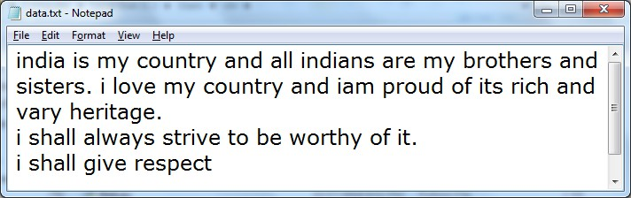
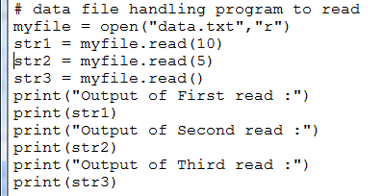
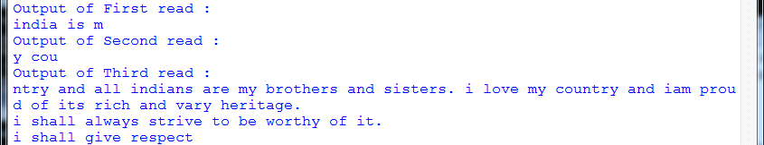
Example-1: read()
SAMPLE FILE

Slide 16
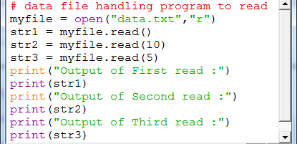
Example-2: read()
SAMPLE FILE

Slide 17
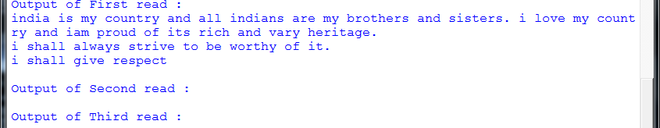

Slide 18
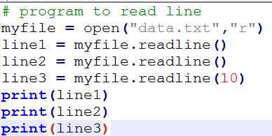
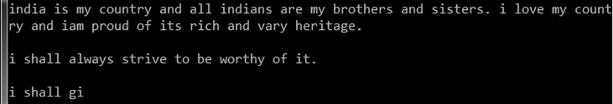
Example-3: readline()
SAMPLE FILE

Slide 19
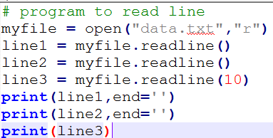
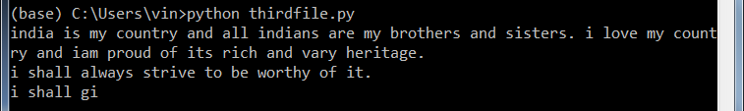
Example-3: readline()
SAMPLE FILE
HAVE YOU NOTICED THE DIFFERENCE IN OUTPUT FROM PREVIOUS OUPUT?

Slide 20
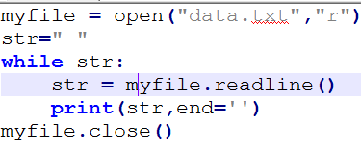


Example-4: reading line by line using readline() with WHILE and FOR LOOP
SAMPLE FILE

Slide 21
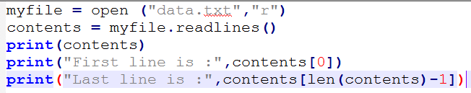
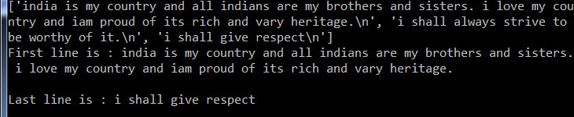
_{Example-5: readlines()}
SAMPLE FILE

Slide 22
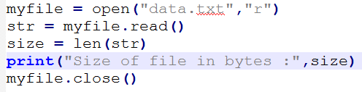
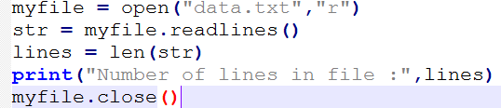
Example-6 & 7: counting size of files in bytes and no.
of lines
SAMPLE FILE

Slide 23
Writing in to files
After read operation, let us take an example of how to write data in disk files. Python provides functions:
write ()
writelines()
The above functions are called by the file handle to write desired content.
Name | Syntax | Description
write() | Filehandle.write(str1) | Writes string str1 to file referenced by filehandle
Writelines() | Filehandle.writelines(L) | Writes all string in List L as lines to file referenced by filehandle.

Slide 24
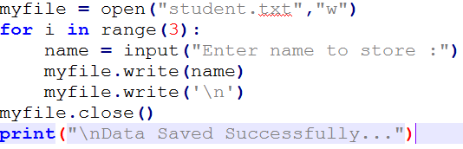
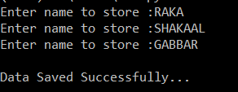
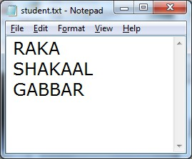
Example-1:
write() using “w” mode

Slide 25
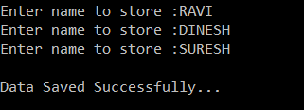
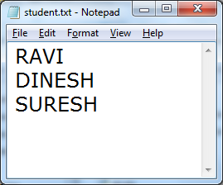
Example-1:
write() using “w” mode
Now we can observe that while writing data to file using “w” mode the previous content of existing file will be overwritten and new content will be saved.
If we want to add new data without overwriting the previous content then we should write using “a” mode i.e. append mode.

Slide 26
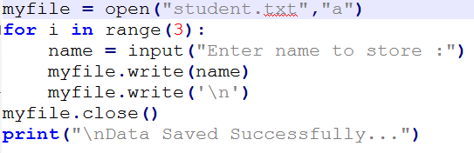
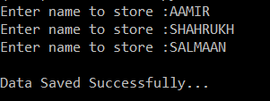
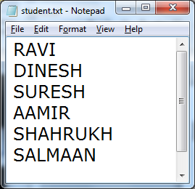
Example-2:
write() using “a” mode
New content is added after previous content

Slide 27
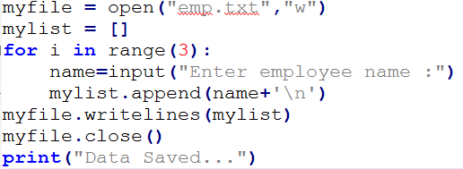

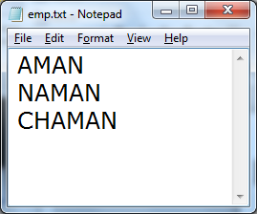
Example-3:
using writelines()

Slide 28
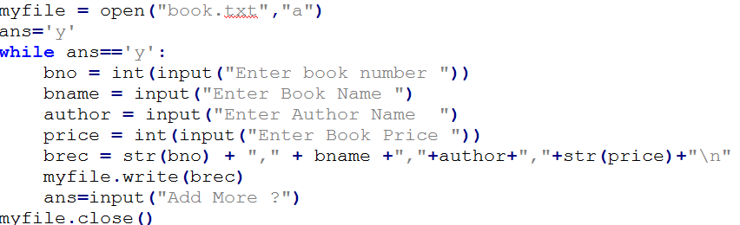
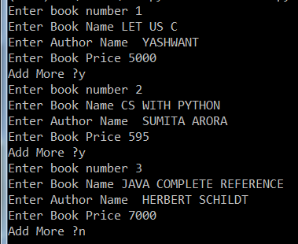
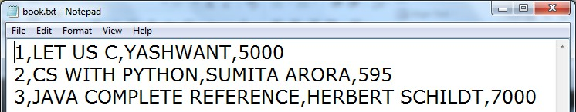
Example-4: Writing String as a record to file

Slide 29
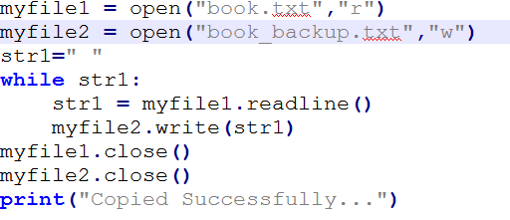

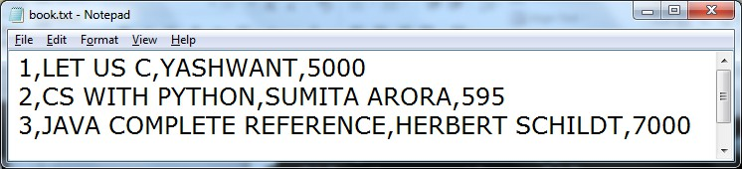
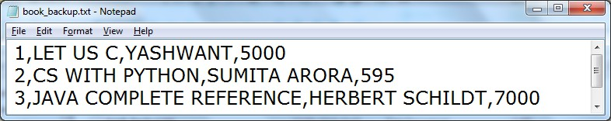
Example-4: To copy the content of one file to another file

Slide 30
flush() function
When we write any data to file, python hold everything in buffer (temporary memory) and pushes it onto actual file later. If you want to force Python to write the content of buffer onto storage, you can use flush() function.
Python automatically flushes the files when closing them i.e. it will be implicitly called by the close(), BUT if you want to flush before closing any file you can use flush()

Slide 31

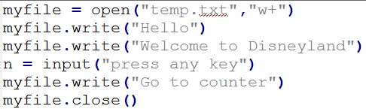
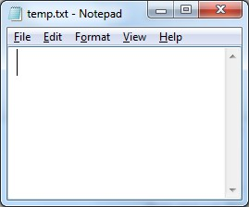
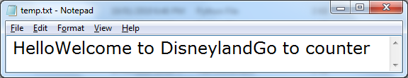
Example: working of flush()
Nothing is in the file temp.txt
Without flush()
When you run the above code, program will stopped at “Press any key”, for time being don’t press any key and go to folder where file “temp.txt” is created an open it to see
what is in the file till now
NOW PRESS ANY KEY….
Now content is stored, because of close() function contents are flushed and
pushed in file

Slide 32
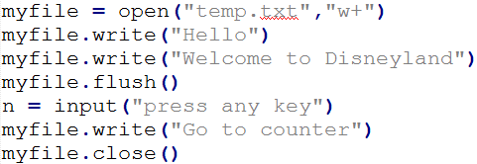
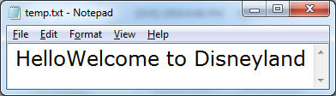
Example: working of flush()
All contents before flush() are present in file
With flush()
When you run the above code, program will stopped at “Press any key”, for time being don’t press any key and go to folder where file “temp.txt” is created an open it to see
what is in the file till now
NOW PRESS ANY KEY….
Rest of the content is written because of close(), contents are flushed and
pushed in file.

Slide 33
File Pointer
Every file maintains a file pointer which tells the current position in the file where reading and writing operation will take.
When we perform any read/write operation two things happens:
The operation at the current position of file pointer
File pointer advances by the specified number of bytes.

Slide 34
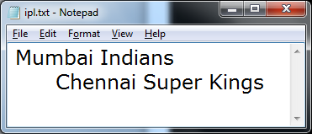
Example
myfile = open(“ipl.txt”,”r”)
File pointer will be by default at first position i.e. first character
ch = myfile.read(1)
ch will store first character i.e. first character is consumed, and file pointer will move to next character

Slide 35
File Modes and Opening position of file pointer
FILE MODE | OPENING POSITION
r, r+, rb, rb+, r+b | Beginning of file
w, w+, wb, wb+, w+b | Beginning of file (overwrites the file if file already exists
a, ab, a+, ab+, a+b | At the end of file if file exists otherwise creates a new file

Slide 36
Standard INPUT, OUTPUT and ERROR STREAM
Standard Input : Keyboard
Standard Output
Standard error
: Monitor
: Monitor
Standard Input devices(stdin) reads from keyboard
Standard output devices(stdout) display output on monitor
Standard error devices(stderr) same as stdout but normally for errors only.

Slide 37
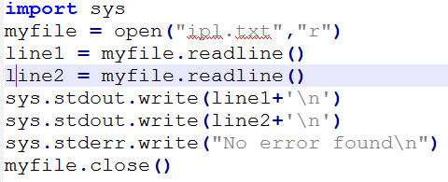

Standard INPUT, OUTPUT and ERROR STREAM
The standard devices are implemented as files called standard streams in Python and we can use them by using sys module.
After importing sys module we can use standard streams stdin, stdout, stderr

Slide 38
“with” statement
Python’s “with” statement for file handling is very handy when you have two related operations which you would like to execute as a pair, with a block of code in between:
with open(filename[, mode]) as filehandle: file_manipulation_statement
The advantage of “with” is it will automatically close the file after nested block of code. It guarantees to close the file how nested block exits even if any run time error occurs

Slide 39

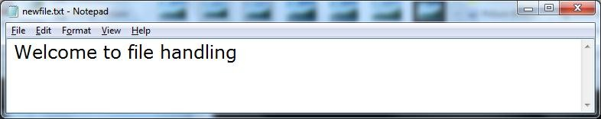
Example

Slide 40
Binary file operations
If we want to write a structure such as list or dictionary to a file and read it subsequently we need to use the Python module pickle. Pickling is the process of converting structure to a byte stream before writing to a file and while reading the content of file a reverse process called Unpickling is used to convert the byte stream back to the original format.

Slide 41
Steps to perform binary file operations
First we need to import the module called pickle.
This module provides 2 main functions:
dump() : to write the object in file which is loaded in binary mode
🞍 Syntax : dump(object_to_write, filehandle)
load() : dumped data can be read from file using load() i.e. it is used to read object from pickle file.
🞍 Syntax: object = load(filehandle)

Slide 42
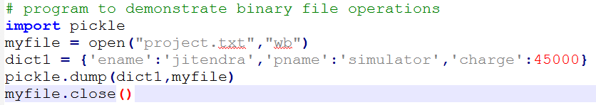
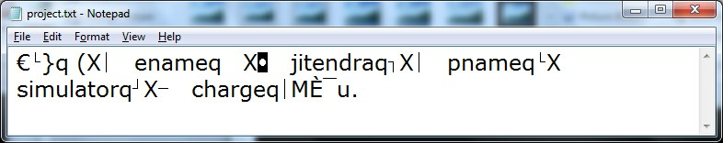
Example: dump()
See the content is some kind of encrypted format, and it is not in complete readable
form

Slide 43

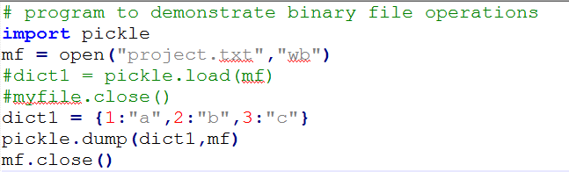
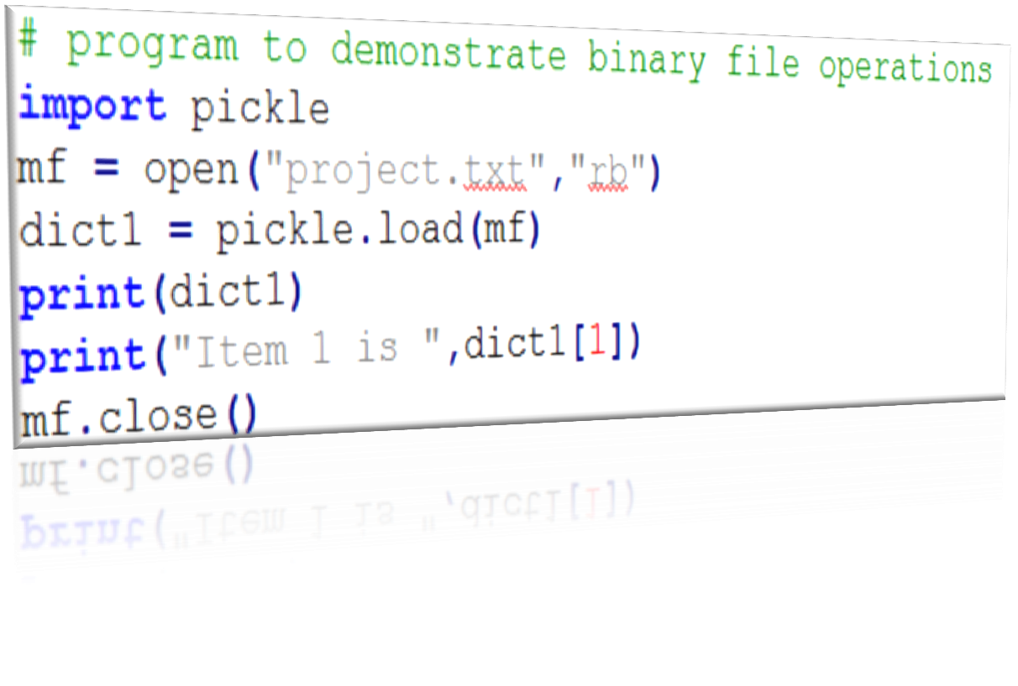

Example: load()

Slide 44
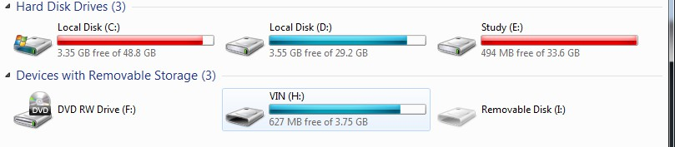
Absolute Vs Relative PATH
To understand PATH we must be familiar with the terms: DRIVE, FOLDER/DIRECTORY, FILES.
Our hard disk is logically divided into many parts called DRIVES like C DRIVE, D DRIVE etc.

Slide 45
Absolute Vs Relative PATH
The drive is the main container in which we put everything to store.
The naming format is : DRIVE_LETTER:
For e.g. C: , D:
Drive is also known as ROOT DIRECTORY.
Drive contains Folder and Files.
Folder contains sub-folders or files
Files are the actual data container.

Slide 46

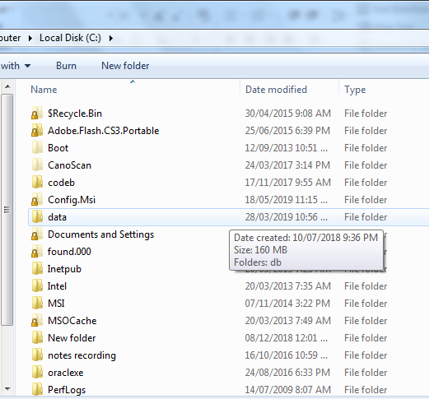



Absolute Vs Relative PATH
DRIVE
FOLDER

Slide 47
DRIVE/FOLDER/FILE HIERARCHY
C:\
DRIV
E
SALES
IT
HR
PROD
FOLDE
R
FOLDE
R
FOLDE
R
FOLDE
R
2018
2019
MEMBERS.DOC
NOIDA
DELHI
FOLDE
R
FOLDE
R
FOLDE
R
FOLDE
R
FOLDE
R
REVENUE.TXT
SHEET.XLS
SEC_8.XLS
SEC_12.PPT
FILE
FILE
FILE
FILE

Slide 48
Absolute Path
Absolute path is the full address of any file or folder from the Drive i.e. from ROOT FOLDER. It is like:
Drive_Name:\Folder\Folder…\filename
For e.g. the Absolute path REVENUE.TXT will be
C:\SALES\2018\REVENUE.TXT
Absolute path of SEC_12.PPT is
C:\PROD\NOIDA\Sec_12.ppt
of file

Slide 49
Relative Path
Relative Path is the location of file/folder from the current folder. To use Relative path special symbols are:
Single Dot ( . ) : single dot ( . ) refers to current folder.
Double Dot ( .. ) : double dot ( .. ) refers to parent folder
Backslash ( \ ) : first backslash before (.) and double dot( .. ) refers to ROOT folder.

Slide 50
Relative addressing
Current working directory
C:\
DRIVE
SALES
IT
HR
PROD
FOLDER
FOLDER
FOLDER
FOLDER
2018
2019
MEMBERS.DOC
NOIDA
DELHI
FOLDER
FOLDER
FOLDER
FOLDER
FOLDER
REVENUE.TXT
SHEET.XLS
SEC_8.XLS
SEC_12.PPT
FILE
FILE
FILE
FILE
SUPPOSE CURRENT WORKING DIRECTORY IS : SALES
WE WANT TO ACCESS SHEET.XLS FILE, THEN RELATIVE ADDRESS WILL BE
.\2019\SHEET.XLS

Slide 51
Relative addressing
Current working directory
C:\
DRIVE
SALES
IT
HR
PROD
FOLDER
FOLDER
FOLDER
FOLDER
2018
2019
MEMBERS.DOC
NOIDA
DELHI
FOLDER
FOLDER
FOLDER
FOLDER
FOLDER
REVENUE.TXT
SHEET.XLS
SEC_8.XLS
SEC_12.PPT
FILE
FILE
FILE
FILE
SUPPOSE CURRENT WORKING DIRECTORY IS : DELHI
WE WANT TO ACCESS SEC_8.XLS FILE, THEN RELATIVE ADDRESS WILL BE
..\NOIDA\SEC_8.XLS

Slide 52
Getting name of current working directory
import os
pwd = os.getcwd() print("Current Directory :",pwd)

Slide 53
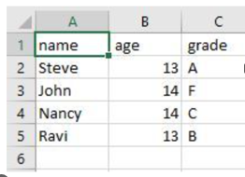
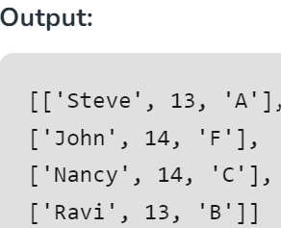
Reading and writing csv file in Python
CSV (stands for comma separated values) format is a commonly used
data format used by spreadsheets.
The csv module in Python's standard library presents classes and methods to perform read/write operations on CSV files.
import csv
# opening the CSV file
with open('Giants.csv', mode ='r')as file:
# reading the CSV file
csvFile = csv.reader(file)
# displaying the contents of the CSV file
for lines in csvFile:
print(lines)

Slide 54
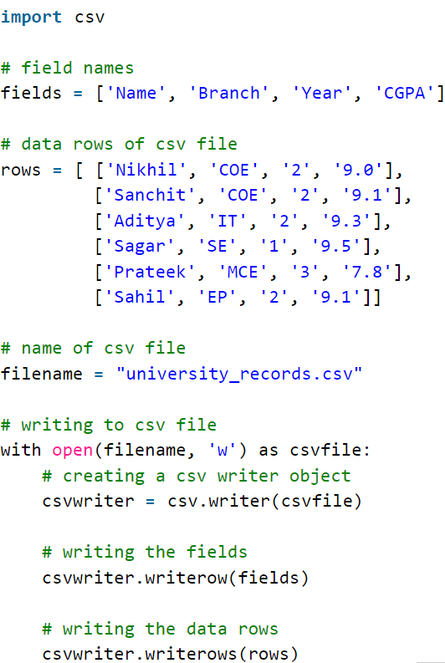

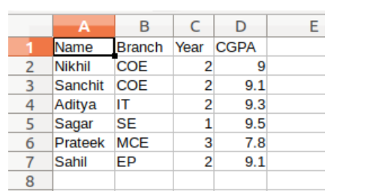
Writing in csv file

Slide 55
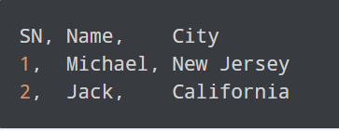
Python CSV: Read and Write CSV Files
The CSV (Comma Separated Values) format is a common and straightforward way to store tabular data. To represent a CSV file, it should have the .csv file extension.
Now, let's proceed with an example of the info .csv file and its data.

Slide 56

Working With CSV Files in Python
Python provides a dedicated csv module to work with csv files. The module includes various methods to perform different operations.
However, we first need to import the module using:

Slide 57
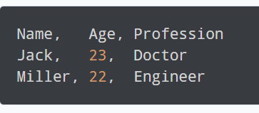

Read CSV Files with Python
The csv module provides the csv.reader() function to read a CSV file.
Suppose we have a csv file named people.csv with the following entries.
Let’s read the CSV:
import csv
with open('people.csv', 'r') as file:
reader = csv.reader(file)
for row in reader:
print(row)

Slide 58

Here, we have opened the people.csv file in reading mode using:
with open(people.csv', 'r') as file:
We then used the csv.reader() function to read the file.
The csv.DictReader() class can be used to read the CSV file into a dictionary, offering a more user-friendly and accessible method.
Suppose we want to read the following people.csv file.
import csv
with open('people.csv', 'r') as file:
csv_file = csv.DictReader(file)
for row in csv_file:
print(row)

Slide 59

Write to CSV Files with Python
The csv module provides the csv.writer() function to write to a CSV file.
Let's look at an example.
import csv
with open('protagonist.csv', 'w', newline='') as file:
writer = csv.writer(file) writer.writerow(["SN", "Movie", "Protagonist"])
writer.writerow([1, "Lord of the Rings", "Frodo Baggins"]) writer.writerow([2, "Harry Potter", "Harry Potter"])
When we run the above program, a protagonist.csv file is created with the following content:

Slide 60

Using Python Pandas to Handle CSV Files
Pandas is a popular data science library in Python for data manipulation and analysis.
If we are working with huge chunks of data, it's better to use pandas to handle CSV files for ease and efficiency.
Read CSV Files
To read the CSV file using pandas, we can use the read_csv() function.

Slide 61

Write to a CSV Files
To write to a CSV file, we need to use the to_csv() function of a DataFrame.

